Slide 1
Software development
The Mad Lib program

Slide 2
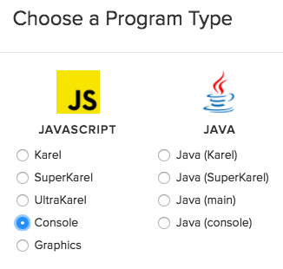
Software Development
START WITH A SIMPLE PROBLEM TO SOLVE
First, create a program that asks for 4 words and uses them to make a story.
Go to the SANDBOX and make a JavaScript console program.

Slide 3
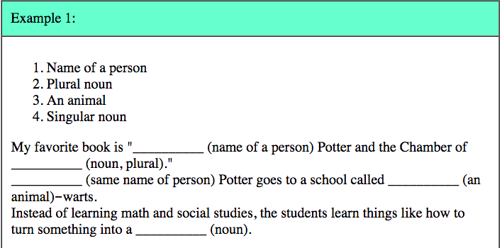
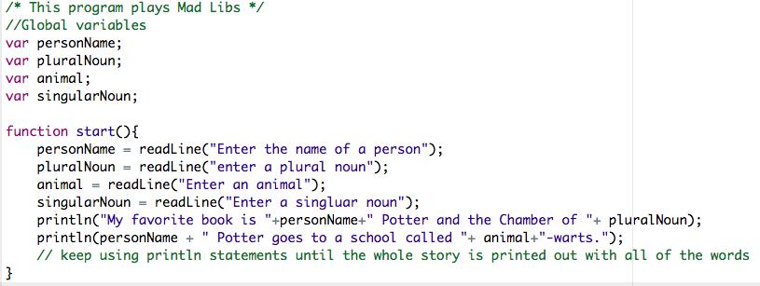
First, create a program that asks for 4 words and uses them to make a story.
Use your words and your sentence.

Slide 4
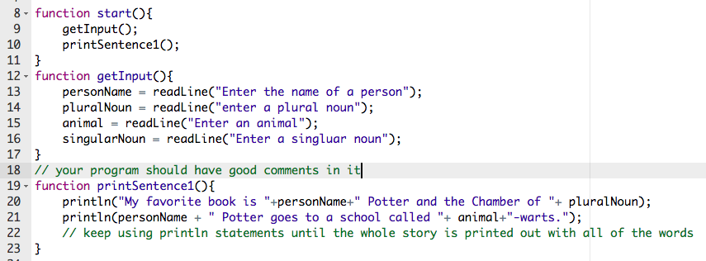
2nd, Break the program up into 2 separate functions and make sure it still works.

Slide 5
3rd, Create another function that will print out a different sentence using your same words. Test it to make sure it works.

Slide 6
4th, make the program work so that the first sentence prints out, and then the second sentence prints out ONLY if the user says they want another sentence.

Slide 7
5th, make the program loop with a while loop
By the way, do NOT make a variable with the name continue… it is a special, reserved word in JavaScript

Slide 8
Don’t forget to add all the things in the rubric!
Be sure you use good variable names, comments, functions, indentation

