Slide 1
Building virtual circuits

Slide 2
Review: Match the terms
Voltage _____
Current _____
Resistance _____
Conductor _____
Insulator _____
Voltmeter _____
Ammeter _____
A tool to measure current
Something that is not good at conducting electricity
The flow of electric charge
The pressure from an electrical circuit’s power source that pushes charged electrons
A tool to measure volts
Something that is good at conducting electricity
Opposing the flow of electricity

Slide 3
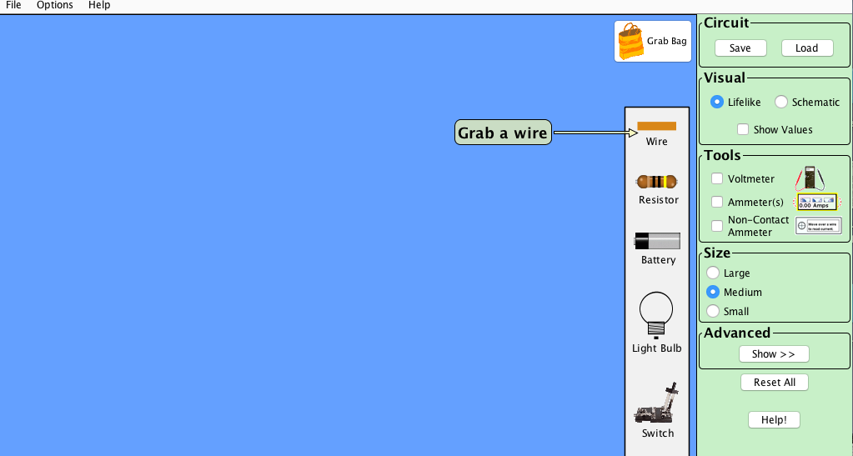
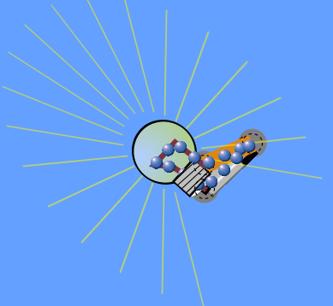
What is the MINIMUM number of parts you could use to light up a light bulb?

Slide 4
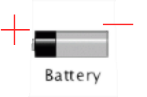
Which direction do the electrons flow?
From negative to positive

Slide 5
Which of the 4 circuit components is optional?
Voltage source
Conductor (wire)
Resistance
Switch

Slide 6
Which component in the simulation can stretch and shrink?

Slide 7
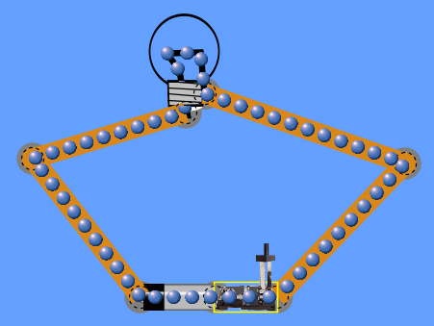
Why won’t the bulb light up in this circuit?
The switch is open
Other possible reasons a circuit
Might not produce light:
Not enough voltage
Too much resistance
If there’s a break in the circuit

Slide 8
How do you detach components?
Right click

Slide 9
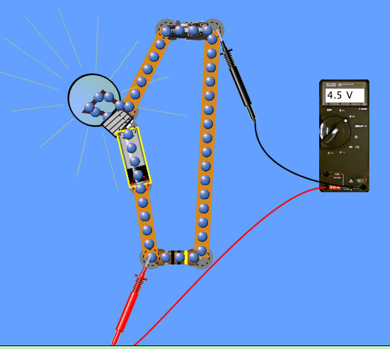
How do you measure the change in voltage with the voltmeter?
Put one lead on each side of the battery on a connector

Slide 10
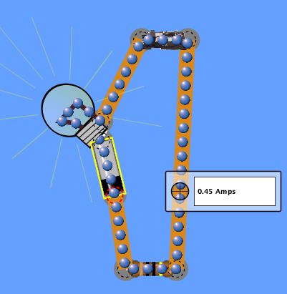
How do you measure the current?
Put the non-contact ammeter over top of flowing electrons.

