Slide 1
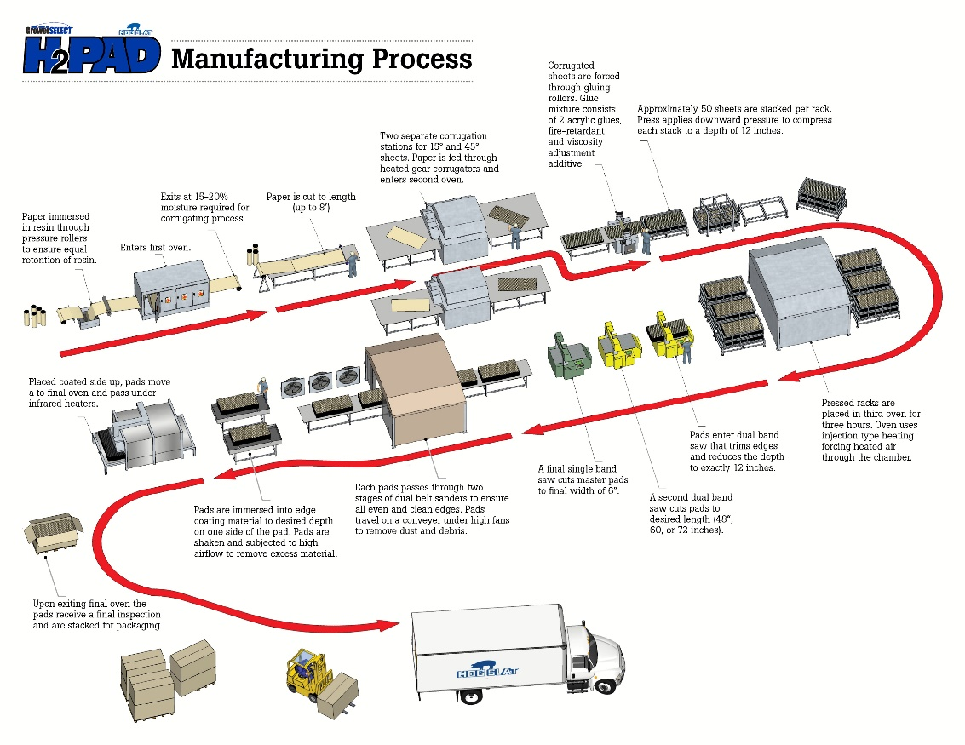
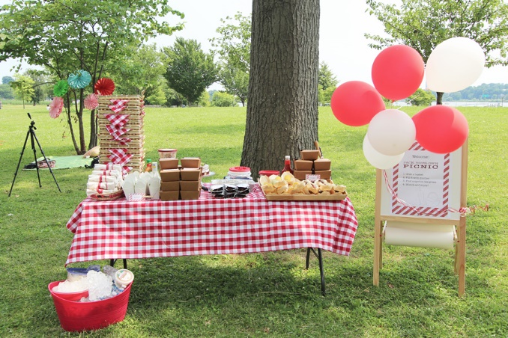
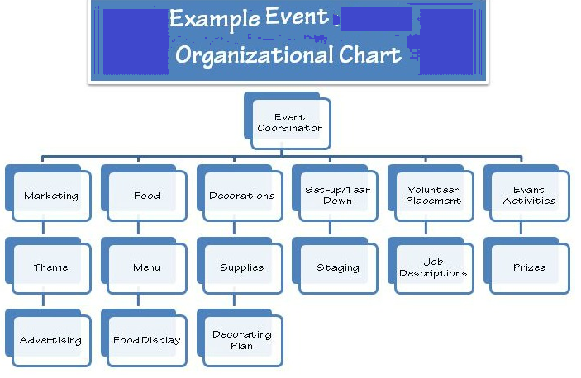
Problem Solving
And visualization

Slide 2
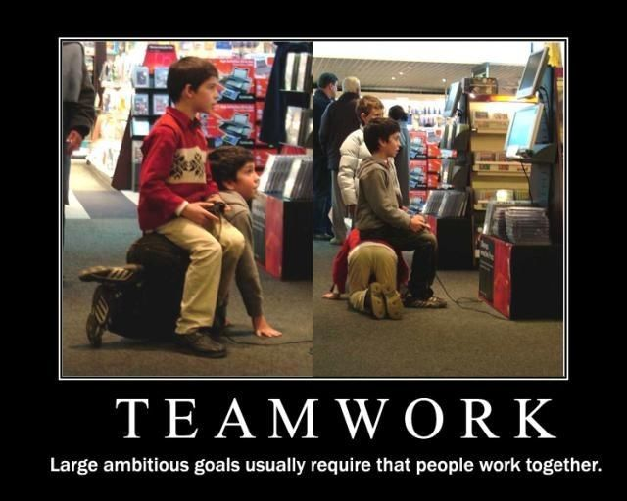
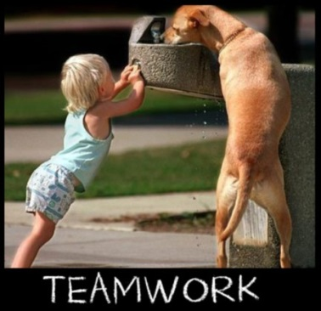
Soft Skills Essential
Teamwork
Problem solving
Attitude
The sum of the individual team members capabilities = the strength of the team.
What’s the strength of our human capital to join today’s team?

Slide 3
What soft skills are in demand?
Organization
Able to find things quickly
Don’t lose anything
Keep yourself on track, finish what you start
Precision
Attention to detail
Quality work all the time
Teamwork
Leadership skills
Bring out the best in others,
Make others feel valued and respected
divide up work efficiently
Communication

Slide 4
What soft skills are in demand?
Problem solving & creativity
Never get stuck, never give up
Ask good questions, find good answers
Always look for a better way

Slide 5
Visual Organizers
Making a diagram can make a presentation more interesting and informative.
Create a visual diagram showing at least 3 steps in the manufacturing process for your item.

Slide 6
Visualize a process
Create a visualization
Organization
Able to find things quickly
Precision
Leadership skills
Problem solving and creativity
Never get stuck, never give up
Don’t lose anything
Keep yourself on track, finish what you start
Teamwork
Attention to detail
Quality work all the time
Bring out the best in others,
Make others feel valued and respected
divide up work efficiently
Communication
Ask good questions, find good answers
Always look for a better way
ASSIGNMENT:
PowerPoint insert smart art.
Add pictures.
Print it out and keep it in your folder.

Slide 7
Am I really finished?
Can you proudly say that this is a quality product?
Is there anything you can improve?
Did you do the bare minimum or did you go above and beyond?
Did you double check details?
Is your name on it?
Did you cite your sources?
Did you follow all the directions?

