Slide 1
Recursion
The only way to understand recursion is to understand recursion
From Barb Ericson
Georgia Institute of Technology
June 2008

Slide 2
An example of recursion
Have you ever read the Cat in the Hat Comes Back?
In it a cat visits two children and messes up the house. When the time come to fix up the house.
The cat takes off his hat to show another cat (A) and asks that cat (A) to clean up
That cat takes off his hat to show another cat (B) and asks this cat (B) to clean up
This goes on and on until the final cat Z cleans up the mess using Voom and all the cats go back in the hats

Slide 3
Definition of Recursion
A method that calls itself
A recursive procedure should have some way to stop
There is an ending (terminal) condition
It is often used to break a complex problem into a simpler problem of the same type
Which should eventually lead to the ending condition

Slide 4
Loop vs. recursion
While (not at door)
Take a step
Method step
if not at door, step

Slide 5
Recursive Definitions
Definition of Recursion
See recursion
This is the kind of recursion that never stops
Definition of an ancestor
A person's parents and their ancestors (see the definition of ancestor)
You can list your ancestors by listing your parents and then calling list ancestor on them and so on

Slide 6
Drawing a Tree
A tree has a recursive structure. The trunk of a tree has other branches off of it which in turn have branches off of them, and so on.
If we treat the trunk of the tree like a branch.
We can draw a tree by drawing the trunk
Then create turn one pen left and one pen right (30 degrees) and each draw a smaller tree
Call the same method with a smaller branch size
Stop when the length of the branch gets too small

Slide 7
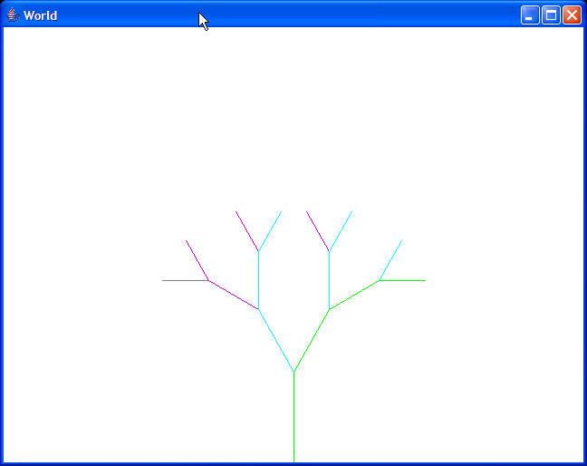
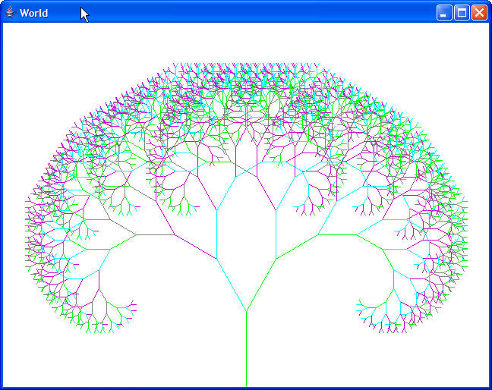
Drawing a Tree with Turtles
After 1 branch is drawn
(the trunk)
After 4 branches
are drawn
Lots of branches
Notes:
This is like an ancestor tree. Each person has 2 parents and they each have two parents and they each have two parents and so on.

Slide 8
Recursive Triangles
If you have a triangle you can break it into 4 new triangles
Create a point at the mid point of each side and connect them with line segments
Now you can break up the resulting 4 triangles

Slide 9
Create a Triangle Class
Each triangle can be defined by 3 points
You can use the Point class in java.
Write a method to subdivide a triangle
Create 3 new points and 4 new triangles
You can call the method on the new triangles
p1
p1
p4
p5
p2
p3
p2
p3
p6

Slide 10
Applications of Recursion
In 3D graphics we break up a sphere into triangles to display
If the sphere is small on the display you don't need many triangles
If the sphere is bigger on the display you need more triangles
Use recursion to get the right amount of triangles based on the displayed size

Slide 11
Processing Files
A directory can have other directories
So you can use a recursive method to list all the files in each directory
Or to create an HTML page with thumbnails of all of the pictures in a directory
Or to follow links on a page (crawl web pages like a spider)

Slide 12
Summary
Recursion features a method that calls itself
With some way to end the recursion
It is used on data structures that are recursive
Like trees
It can also be used for methods that have a recursive definition
Like fibonacci numbers
http://www.mcs.surrey.ac.uk/ Personal/R.Knott/Fibonacci/fibnat.html
Fibonacci of 0 is 0 and of 1 is 1 and of n is Fib(n-1) + Fib(n-2)

