Slide 1
Welcome to the Mighty….
Electronics
Lesson
Safety Tip for the Day…
Don’t try to save time in the morning by bathing with your toaster.

Slide 2
Got Notebook?
Then…Let’s Play Electronics!!!

Slide 3
What is electricity?
Your First Note
How to become richer than Bill Gates overnight…
Find a better way of getting electrons to move from atom to atom…
Electronics is the study and use of moving electrons

Slide 4
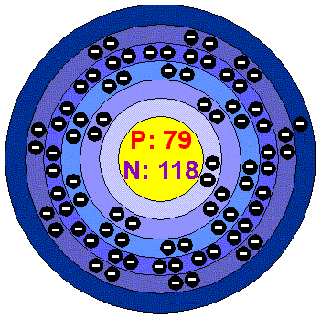
Valence Electrons
Electronics focuses on the electrons in the Valence Shell
Valence electrons are more loosely bound to the atom and easier to move
Too tightly bound to easily move

Slide 5
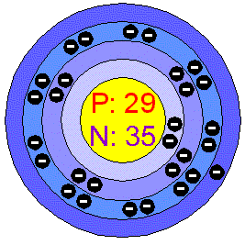
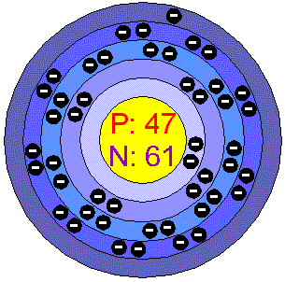
Conductors
3 or Less Electrons in the Valence Shell
What makes a good wire??
Copper
Silver
Gold

Slide 6
So why do we use copper?
$$$
Silver
Copper
Gold

Slide 7
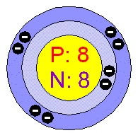
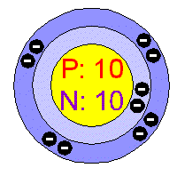
Insulators
5 or More Electrons in the Valence Shell
Wood, Rubber and even PURE H20 all have an atomic structure where there are more than five electrons “free” to move
Yes..There are Neon signs but…they only work at VERY high VOLTAGES
Oxygen
Neon

Slide 8
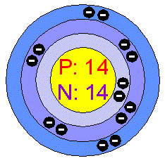
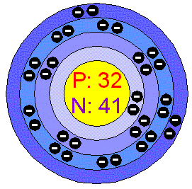
Semi-Conductors
4 Electrons in the Valence Shell
Their chemistry can be “played with” to make them a conductor one instant and an insulator the next…On..Off….0…1 etc.
Digital Electronics, Silicon Valley, “The Chip”, Computers, Cell Phones, and…virtually all modern electronics…
Silicon
Germanium

Slide 9
Question...
Does anyone actually use electricity?

Slide 10
Answer...
…not often. We USE light, heat , mechanical energy (fans, motors etc.) but not often is the output actual electricity…
Can you name any device where we want the FINAL output to be electricity?
…a battery charger’s output is electricity but we really don’t use or need the electricity in the end because when all is said and done we just want the thing to start the motor ( in the same vein of thought no one really USES gasoline but rather the movement it can produce through an engine)

Slide 11
USES for direct electrical output...
a defibulator and an electric chair are the only examples I could come up with…
Isn’t this a great time to talk about the definition of “Irony”?

Slide 12
Vocabulary Word..
LOAD : Any Device that uses the electrical energy to perform a task or do work. Light Bulb, Fan, Computer, New York City, etc.
NOTE: All Loads have a value of Resistance ( they don’t like to just work by themselves…) they need to have the electricity pushed through them …the more work they are required to do, the higher the value of resistance assigned to them

Slide 13
Vocabulary Word..
Transducer: any device that turns one form of energy into another.
Most loads are transducers as they generally turn the electrical energy into one more useable by humans. i.e. fans, heaters, lights, etc.

Slide 14
The Three Parts of a Basic Circuit
2. Load
_
+
1. Power Source
3. Pathway
In this Closed Loop circuit electrons flow from negative to positive THROUGH the load and work gets done

Slide 15
The Three Parts of a Basic Circuit
2. Load
_
+
1. Power Source
3. Pathway
If the pathway from negative to positive is broken no electrons will flow and no work gets done. (This is the function of every switch; to control the flow of electrons by “opening” and “closing” the circuit i.e. “OFF and ON”)

Slide 16
What is Electricity Used For?
A Fast, Cheap, and
Clean Transfer of Energy

Slide 17
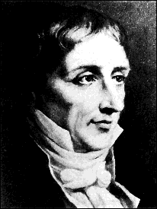
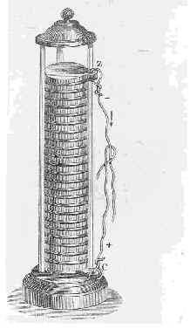
What is Voltage?
Named after Alessandro Volta who invented the first practical battery in 1799
"Reason to Move" or "Push"
Electrons don’t “want” to move from one atom to another. Any force chemical, magnetic, mechanical or whatever that gives them a “Push” or “Reason to move” from one atom onto another is called a voltage… But REMEMBER… just because you are pushing on something does not mean that it will move… there may be too much resistance to movement present even if you are pushing really hard..

Slide 18
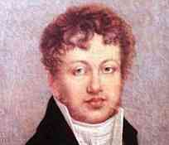
What is Amperage?
Named after Andre Marie Ampere a mathematician who formulated theories that greatly helped solidify the link between electricity and magnetism
"Amount Per Time"
This is the Dangerous part of electricity. Roughly 0.5 Amps of electricity is enough to kill a person.
Yes…this IS an Amp but not the kind intended in this lesson… However, the more “Amps” that run through it, the louder it gets…

Slide 19
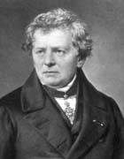
What is Resistance?
No this is not named after anyone named “Resist” It is as the name implies…”Opposition to Movement” All loads and all wires except superconductors have some amount of resistance
"Opposition to Movement"
Resistance is Measured in OHMS and this unit of measurement IS named after the mathematician who discovered the most fundamental law governing the study of electricity… OHM’s LAW. His name was Georg Simon OHM

Slide 20
Mind Teaser...
Ancient classroom Discipline Plan…If you mess up in class.. we take you to the beach, then call the weather bureau and order a tsunami to head straight toward where you are standing…Our Rule… In order to be let back into class you MUST withstand being hit with 10,000,000,000 gallons of water!!!
Question...
How can you follow the rules an still be sure that you will survive??

Slide 21
Answer...
Yes!! Request that you get hit ONE GLASS at a TIME!! You’ll be a bit wrinkled but you will survive
This is an example of the difference between Voltage and Amperage. 10,000 Volts is only “Dangerous” because like all that water, it has the “potential” to do some serious damage… But that is ONLY if it is ALL unleashed at once!
Soooo… High Voltage with LOW Amperage can be safe but HIGH Amperage is ALWAYS dangerous
Soooo… Amount Per Time is what is dangerous

Slide 22
Ohm's Law Analogies
Voltage or “Reason for electrons to Move”
Resistance to Movement
Amperage; The number of Mice per Unit of time that make it to the cheese
Electrons

Slide 23
Ohm's Law Analogies
Voltage
Resistance
Amperage =
5 mice /Second
Electrons
Use ye' smarts...
What are TWO things that can be done to INCREASE the Amperage?

Slide 24
Ohm's Law Analogies
Voltage
Resistance
Amperage =
50 mice /Second
Electrons
DECREASING resistance in a circuit will raise the amperage in the same circuit proportionally OR…

Slide 25
Ohm's Law Analogies
Resistance
Amperage =
50 mice / Second
Voltage
Electrons
Leaving the resistance alone but INCREASING the voltage will also raise the amperage proportionally

Slide 26
Ohm's Law Analogies
Voltage
Resistance
Amperage =
5 mice /Second
Electrons
Use ye' smarts...
What are TWO things that can be done to DECREASE the Amperage?

Slide 27
Ohm's Law Analogies
Voltage
Amperage =
1 mice /Second
Electrons
Resistance
INCREASING resistance in a circuit will decrease the amperage in the same circuit proportionally OR…

Slide 28
Ohm's Law Analogies
Voltage
Amperage =
1 mice /Second
Electrons
Resistance
DECREASING voltage in a circuit will decrease the amperage in the same circuit proportionally

Slide 29
What Happens When...
Resistance
Amperage ??
Voltage
Amperage ??

Slide 30
What Ohm Proved
Resistance
Amperage
Voltage
Amperage
Inversely Proportional
Directly Proportional

Slide 31
Your Turn...
Create your Own Ohm’s Law analogy on a single sheet of paper. It must contain:
A drawing with labels of each part of the analogy (electrons, resistance, amperage, voltage)
And a written description of the TWO ways in which the amperage can be raised and the TWO ways amperage can be lowered.
Jksadjsajdf asdfadsfjasdf jasdfkjsadf
dsgdsafg
dsgdsafg
dsgdsafg
Ksadjfjsadjjdsfkljsadfkljsafjdkljsadfkljsadfjfjdskldsajsdfljasfjdklajdsfkljsadfjksafjdkljdsafkljsadfsadfkjaslfjdklajsdfkljsadfkjsafjdksajdfkjsadfkjsafd
asfjdjdsafklasjdfkljasfjdjdsfklsajdfklajsdfihwairehawkldnfksadnfkljasdihjiafheansfnfeklanwfiejenfansdfnasfdnlakdsf;asdfkl;asndfl;ksandfl;knasd

Slide 32
End of part 1

Slide 33
Ohms Law (the math)
E = Voltage I = Amperage R = Resistance
E = I*R
R = E/I
I =E/R
You could remember all three of these…..or…
E
Use this simple memory device
I
R

Slide 34
Ohms Law
Cover up what you want to find and the formula is presented to you.
E
Divide Line
I
R
Multiply Line
How do you remember the chart? “Every Idiot Remembers”
This of course means that if you forget it you are a genius!

Slide 35
Ohms Law
“OK” …you say….I get that “R” is for Resistance but WHY the E and I??
Before Volts were named after Volta, it was simply called “Electro-motive Force” or backwards, “the force that moves electricity”… SOO…. “E” just stuck to represent voltage when doing calculations

Slide 36
Ohms Law
Alright but what about “I”??
Before Amperage was named after Ampere it was called “Intensity”

Slide 37
Let's Do Math
Pretend one of your classmates, ( go ahead pick one), placed their head where normally a light bulb would go in a circuit. Their head is now the “load”. Every load has an amount or value of resistance to electron movement.

Slide 38
Let's Do Math
Lets say that the “head “ has a resistance of 10 Ohms of resistance…AND the Battery has a Voltage of 100 Volts. (Remember that about 0.5 Amps of electricity traveling through a persons head is enough to kill them)
So… does ( insert name here) Live or Die? Thumbs up or Thumbs down) Do the math…

Slide 39
Let's Do Math
I=E/R = 100/10 = 10AMPS!!
In the language of Baseball……He is outta’ there!
In the language of Food……He is Toast!
Ya’ get the picture…
10 Ohms
100 V
What two things can you do to save this person?

Slide 40
Only Three Circuits to Learn...
There are only three ways to hook up an electric circuit.
If you learn all three and how electricity moves through them, then you understand the fundamental principals of how ALL of electronics works.
Other stuff you will learn along the way...
One of the Ways leads to the Greatest Baby Sitting Tool around.
Another will lead to YOU proving WHY dozens of things should not be plugged into the same outlet.

Slide 41
The Greatest Baby Sitting Tool Ever...
An Introduction to the only three kinds of circuits possible
Every Christmas out come the strings of lights…. Ever plugged in a string and none of them came on? If so… Did you try to find the lights with the extra bulb that came with the package?

Slide 42
A Series Circuit
Only ONE pathway from negative to positive
If one light bulb burns out the rest will not work
The “Extra Bulb”

Slide 43
Now for Babysitting..
Purposefully burnout one light and make sure you know which one it is…
In front of a five year old make a big deal out of “fixing” a set of lights using the ONE extra bulb and one by one replacing each bulb and trying the lights. Make sure to get lots of attention and praise for your efforts.
The “Extra Bulb”

Slide 44
Babysitting continued..
Next… pull out a second set that…for some mysterious reason doesn’t work either and get the five year old to want to show off just like you and gain all sorts of attention by attempting to fix this set with the ONE extra bulb….and yes…make sure you have burned out TWO bulbs this time………..
The “Extra Bulb”

Slide 45
A Parallel Circuit
More than ONE pathway from negative to positive
If one light bulb burns out it will not affect the rest

Slide 46
A Series/Parallel Circuit
Both Series and Parallel sections within the circuit.
If one light bulb burns out it may affect other parts of the circuit

